Slide 1
Domain Oriented case study
Telecom Churn

Slide 2
Dataset
Total 99999 rows, 226 columns
166 columns have null values present
Customers are identified based on the revenue generated. Top 30 percent of such customers (i.e 70th percentile) are selected for the analysis, since their churning prediction is of high criticality (total 30001 customers).
Out of these, 8.14% customers did churn

Slide 3
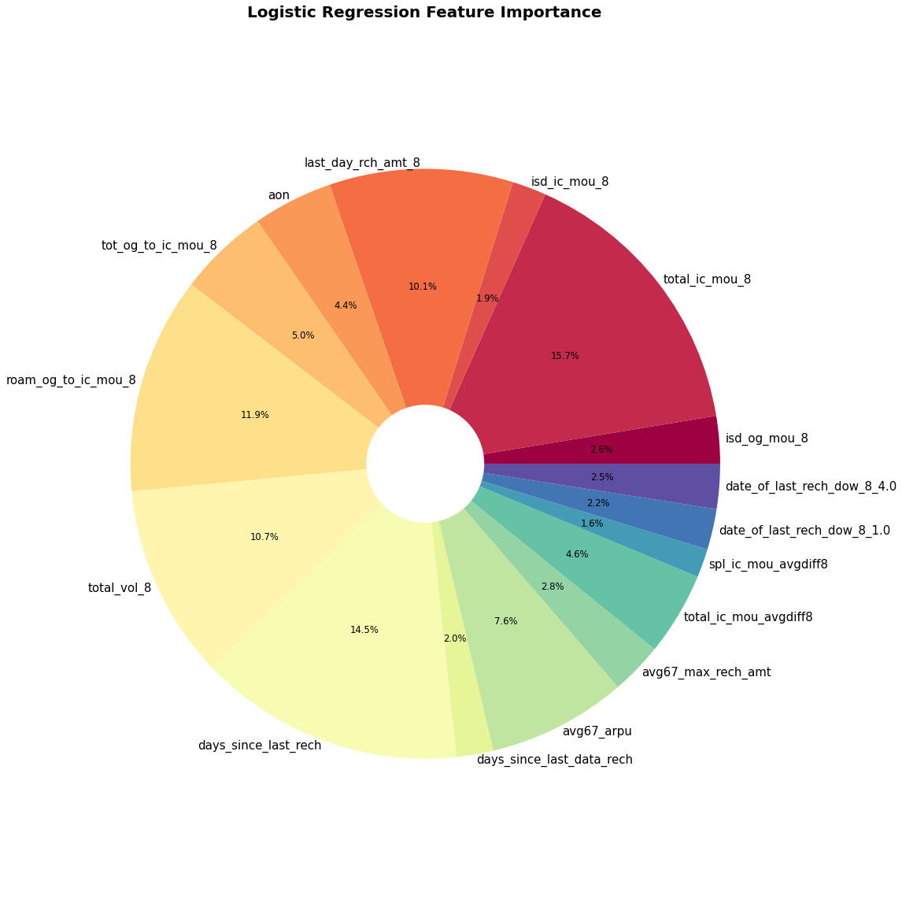
Final insights
Top 10 features for the business were identified, which impact on the decision of customer going to the ‘Churn’ state. These are:
Total incoming minutes of usage for 8th month
Days since last recharge
Roaming outgoing to incoming ratio of minute of usage for 8th month

Slide 4
4. Total volume of data usage (2g + 3g) for 8th month
5. Last day recharge amount for 8th month
6. Avergae revenue per user average for 6th and 7th month
7. Total outgoing to incoming minutes of usage for 8th month
8. Total incoming minutes of usage average 6th and 7th month difference from 8th month
9. Age on network
10. Average of 6th and 7th month maximum recaherge amount
AS we can see, the most recent month playes an important role in the churn possibility (i.e. 8th month calls, data usage, recharge amount etc.) and hence this monitoring should be prioritized to prevent the churn. E.g. if the usage drops, introducing personalized schemes to increase the internet usage, etc.

